Slide 1

Biodiversity patterns and how they emerge
Petr Keil

Slide 2
Latitudinal gradients of biodiversity
From the tropics towards the poles

Slide 3
Latitudinal gradient
Birds across the New World (grid cells of ~ 611,000 km²)
Storch & Gaston (2004) Basic and Applied Ecology

Slide 4
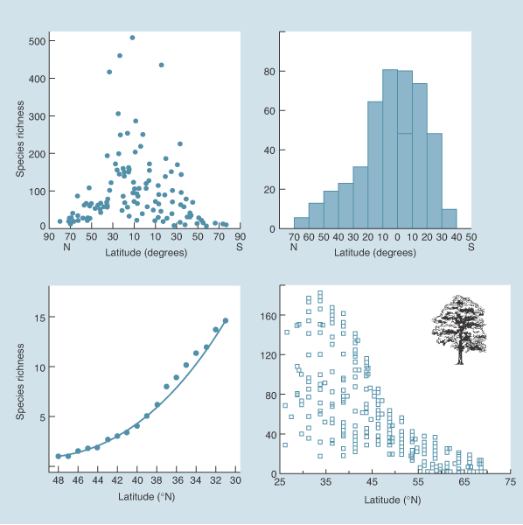
Latitudinal gradient
marine bivalves
butterflies
US lizards
trees
Begon et al. (2004) Ecology (the textbook)

Slide 5
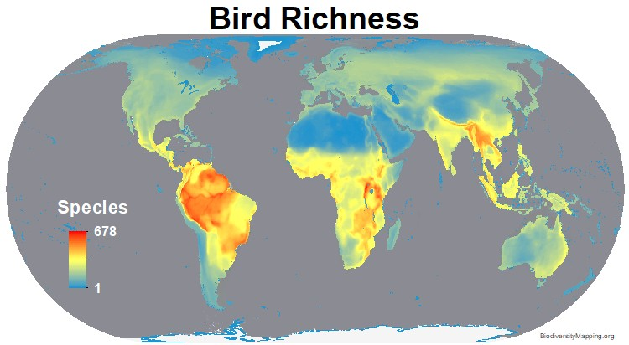
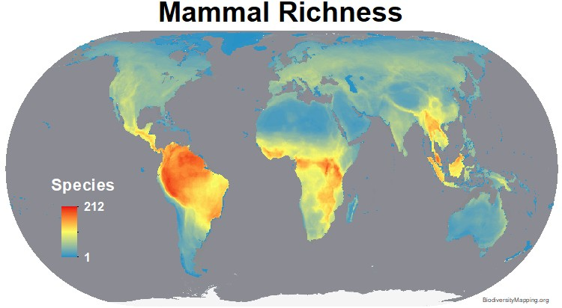
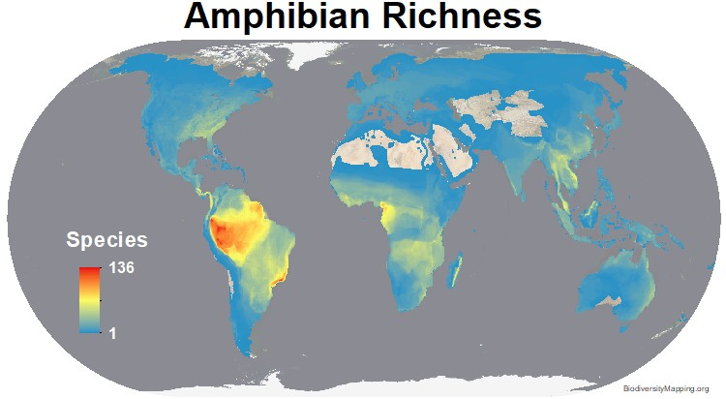
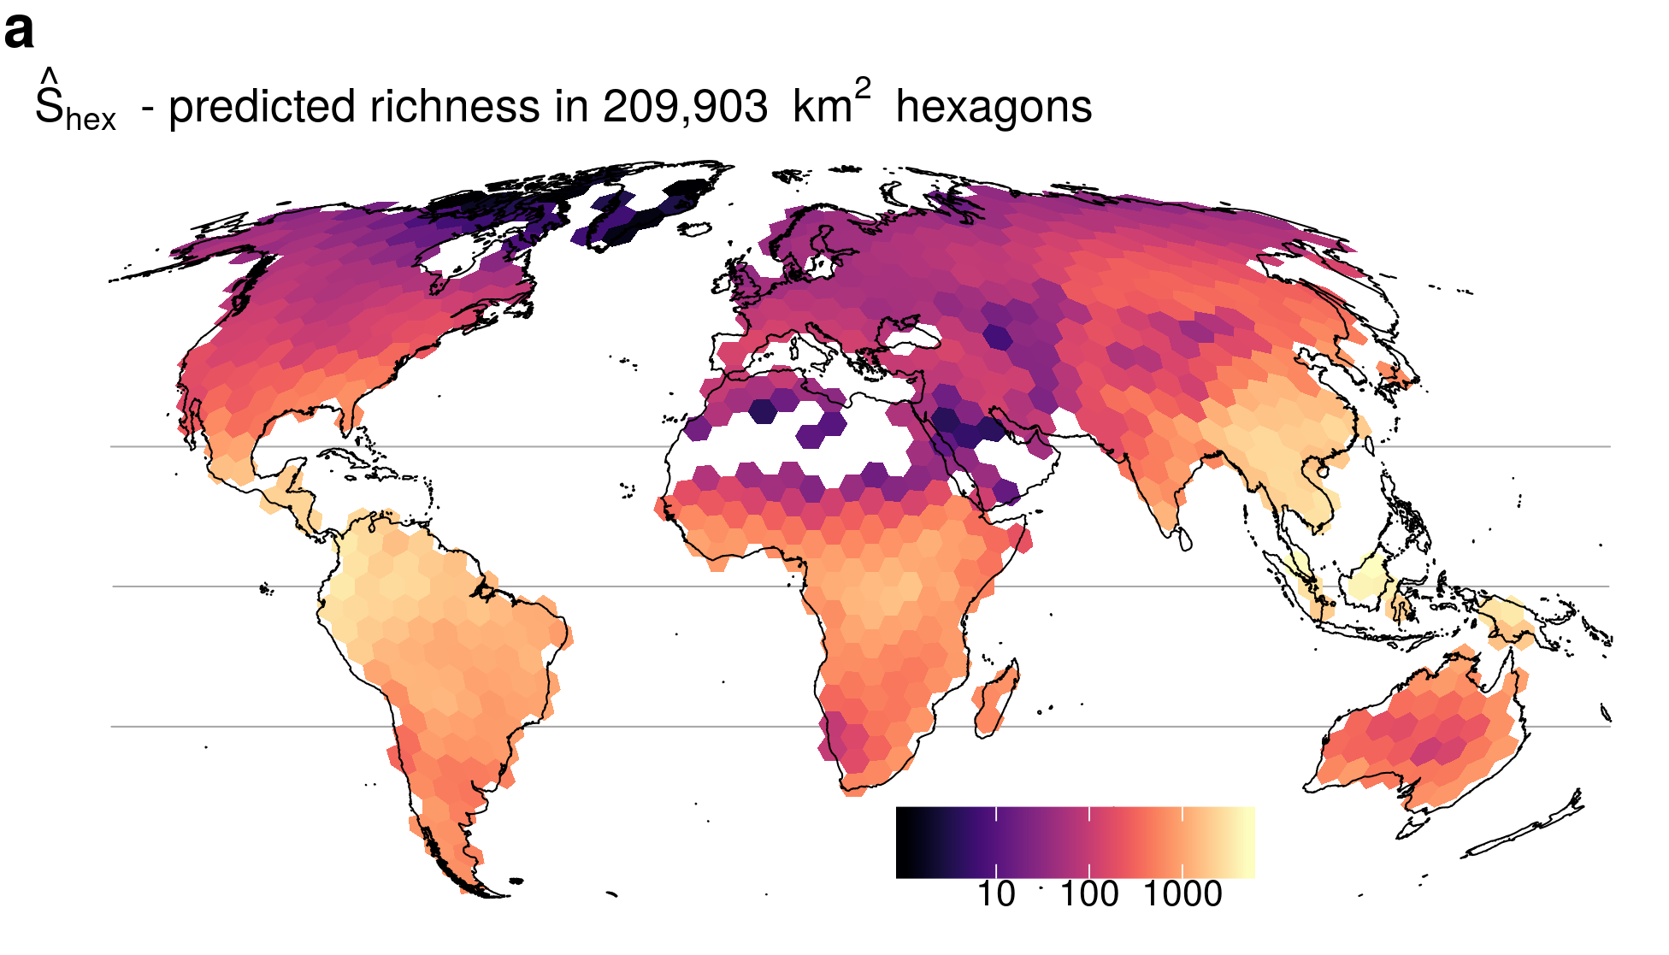
Latitudinal gradient
Tree Richness
BiodiversityMapping.org; Keil & Chase (2019) Nature Communications

Slide 6
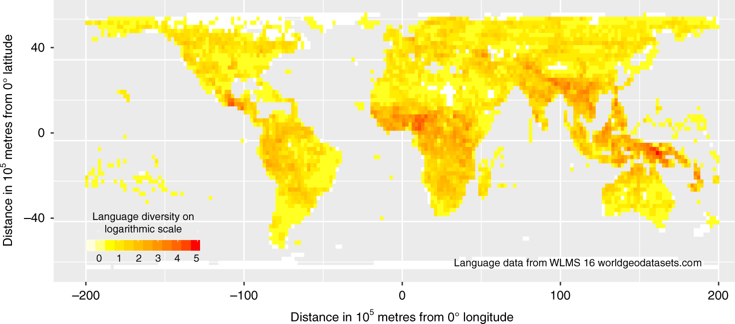
Also holds for languages
Mace & Pagel (1995) Proc R Soc B
Hua et al. (2019) Nature Communications
Notes:
In this panel we can probably all agree that biodiversity is one of the most valuable natural resources.
But things like climate change or habitat loss are a threat to biodiversity, to the extent that we hear about biodiversity crisis, or sixth mass extinction
For example, about 1% of vertebrate species have gone extinct because of humans

Slide 7
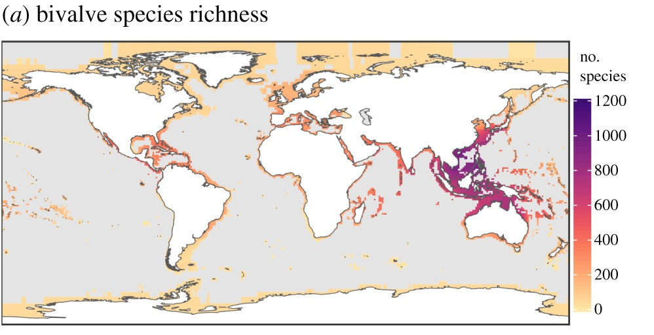
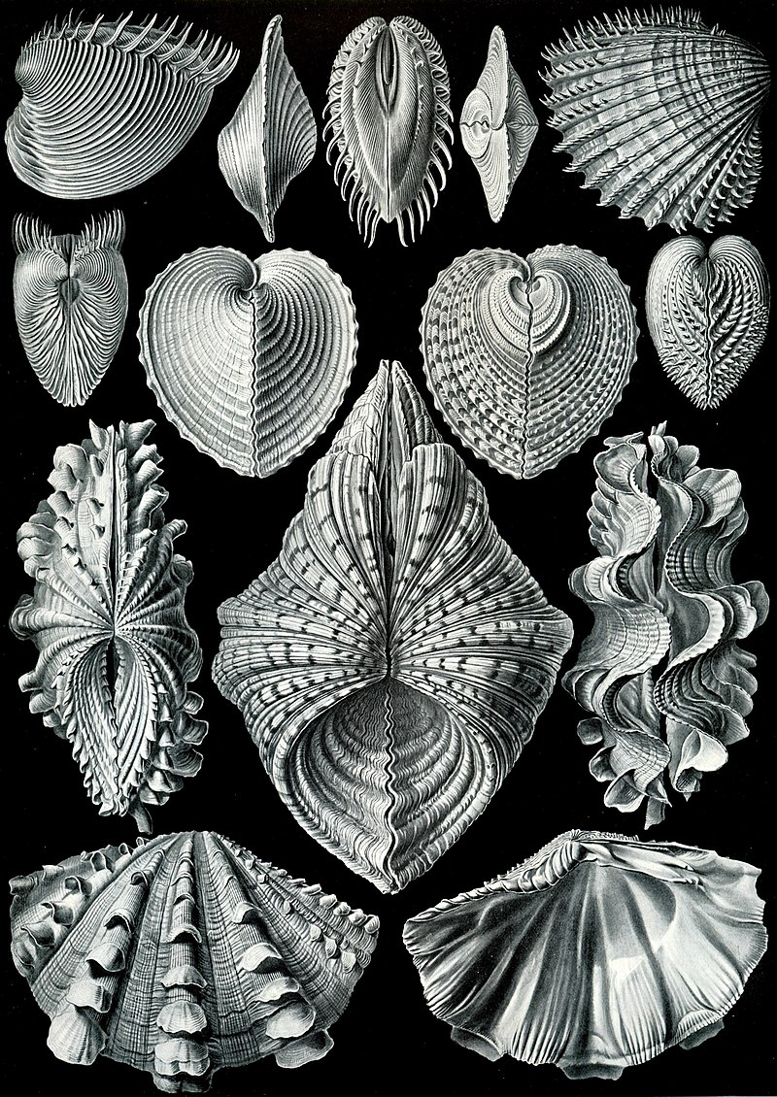
Latitudinal gradient in the sea
Schumm et al. (2019) Proc R Soc B

Slide 8
Exceptions and irregularities …
Keil & Chase (2019) Nature Ecology & Evolution

Slide 9
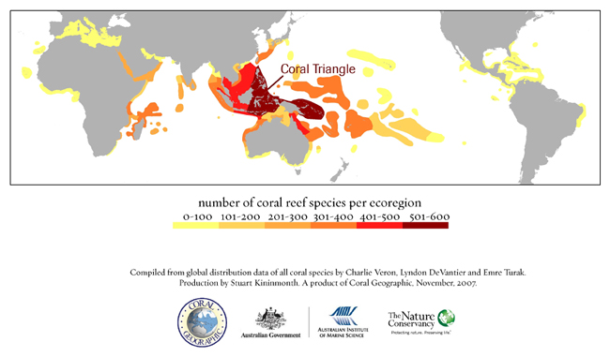
Exceptions and irregularities …

Slide 10
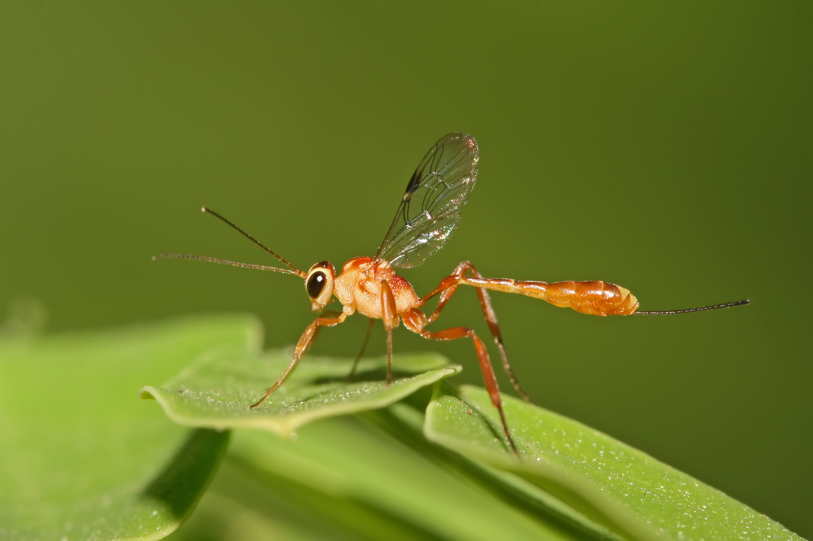
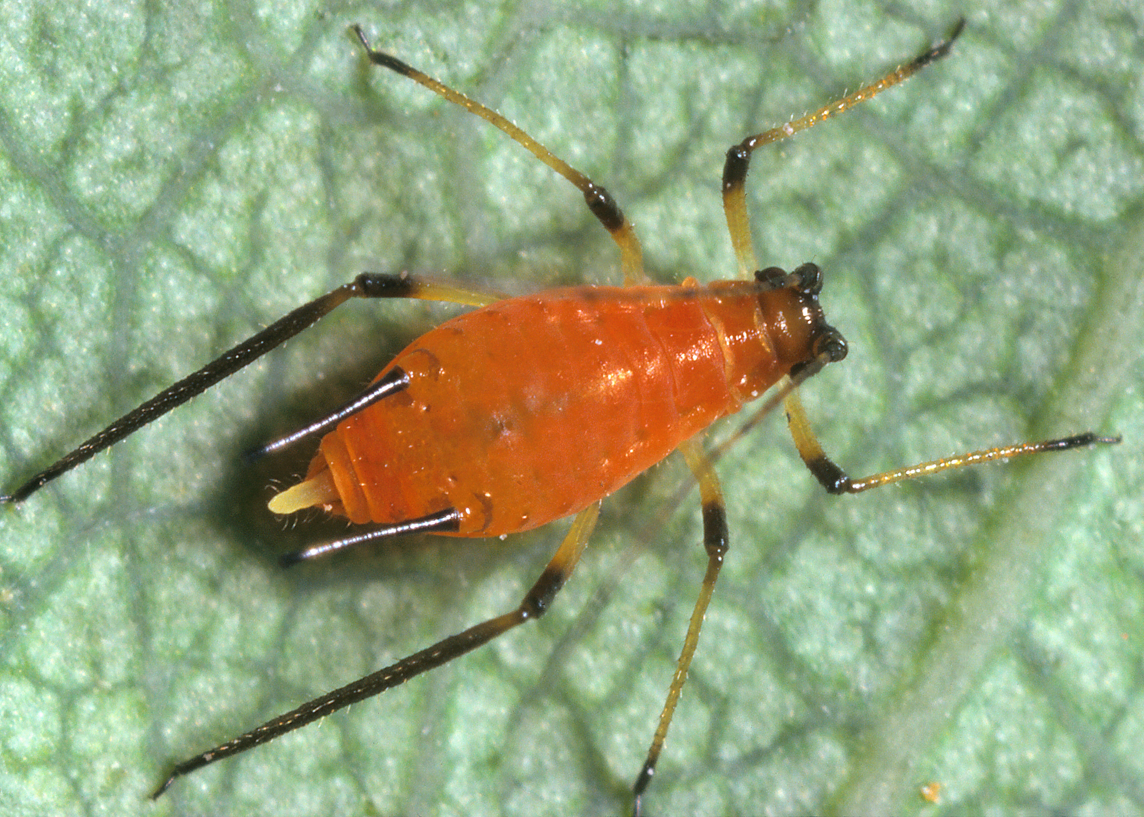
There area alco inverse latitudinal gradients (lower richness in the tropics)
Ichneumonids
Aphids
Marine benthic algae
Pitcher platn mosquito
Shallow-water molluscs
Kindlmann et al. (2005) Chapter in “Scaling Biodiveristy” by Storch et al.

Slide 11
You should know
Latitudinal gradient of species diversity is one of the most pronounced macroecological patterns
It’s fascinated ecologists for centuries
For majority of taxa, the latitudinal gradient consists of high diversity in the tropics, and its decrease towards the poles
However, the decrease is not always monotonous, sometimes there are humps
There are taxa in which we observe and inversed latitudinal gradient

Slide 12
Explaining the latitudinal gradient
There is > 30 hypotheses
Notes:
I am qualified to deliver all this

Slide 13
1. Geometry, statistics, mathematics
Perhaps there is nothing biological about biodiversity patterns
Notes:
I am qualified to deliver all this

Slide 14
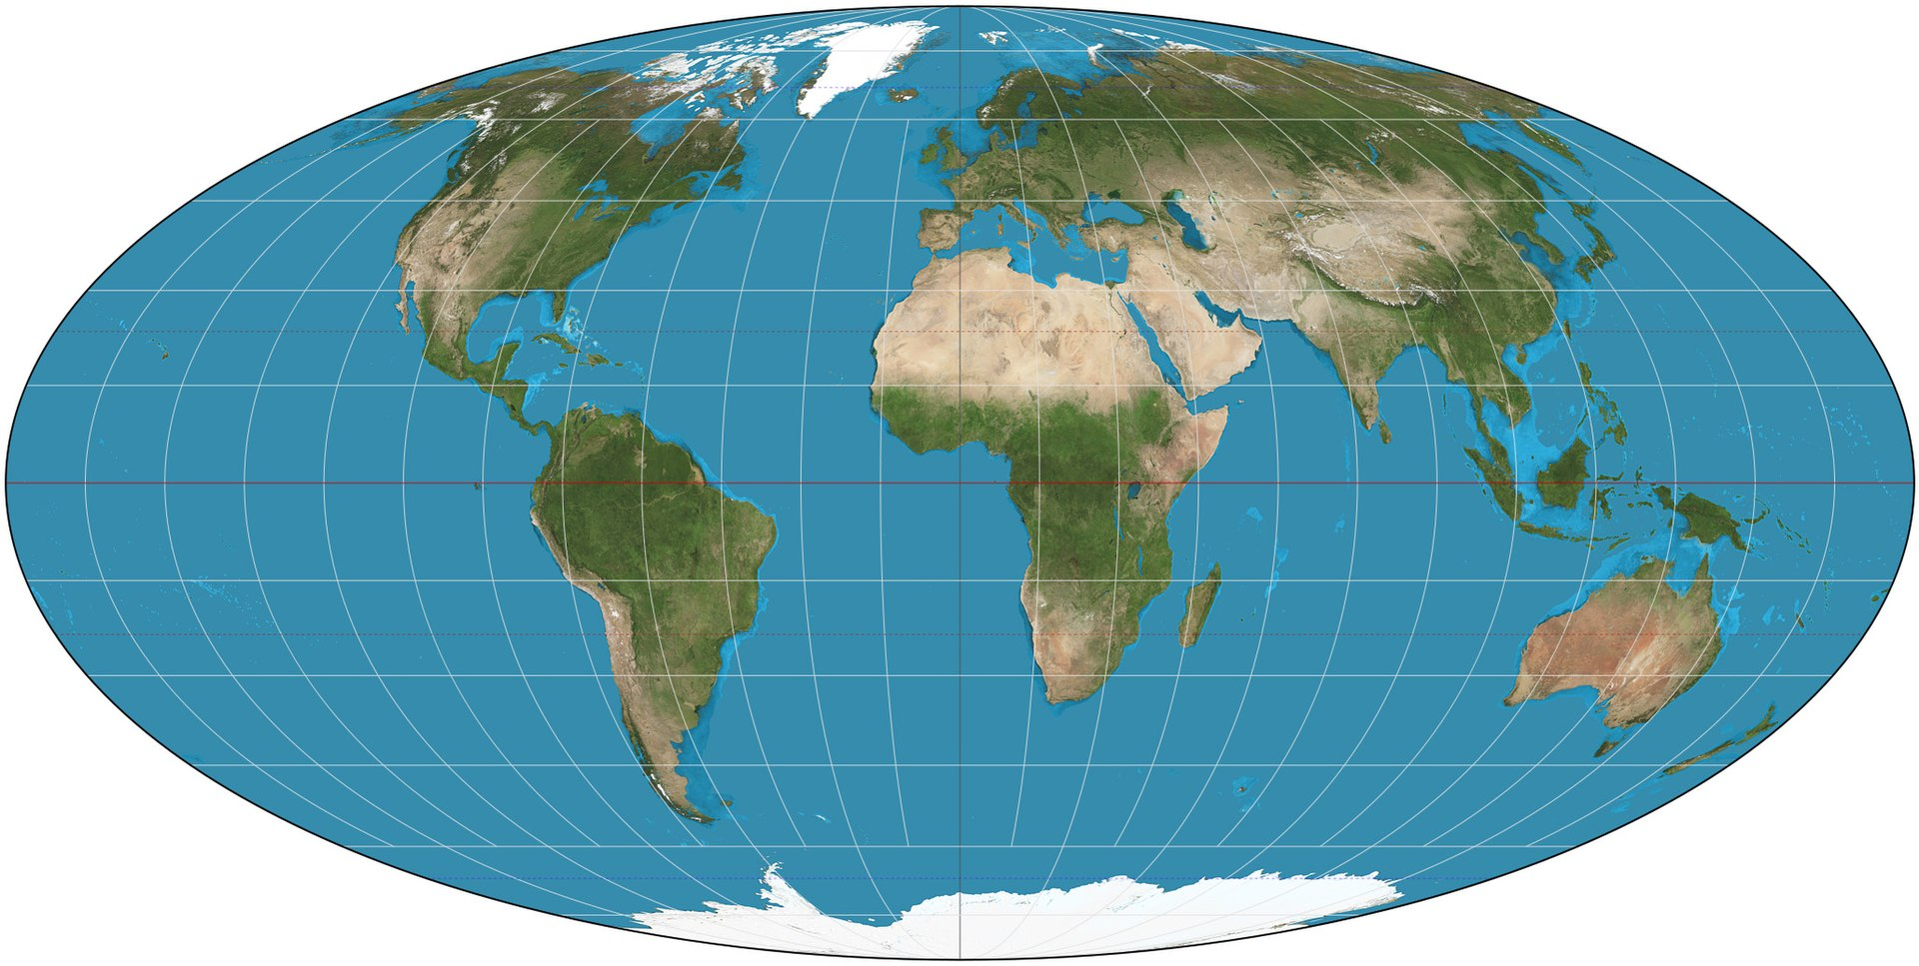
The tropics are bigger… or, are they really?
Rosenzweig (1995) Species Diversity in Space and Time
Rohde (1997) Oikos

Slide 15
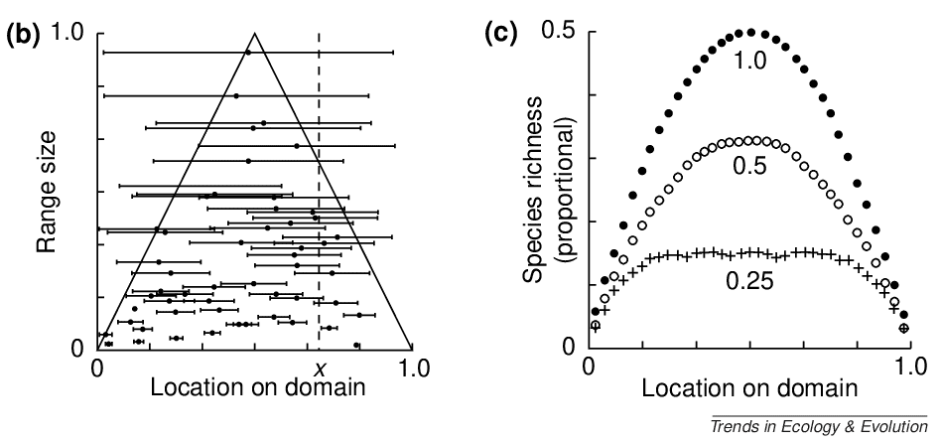
The mid-domain effect
The increasing overlap of species ranges towards the centre of a shared geographic domain due to geometric boundary constraints in relation to the distribution of species' range sizes and midpoints.
Colwell & Lees (2000) Trends in Ecology & Evolution

Slide 16
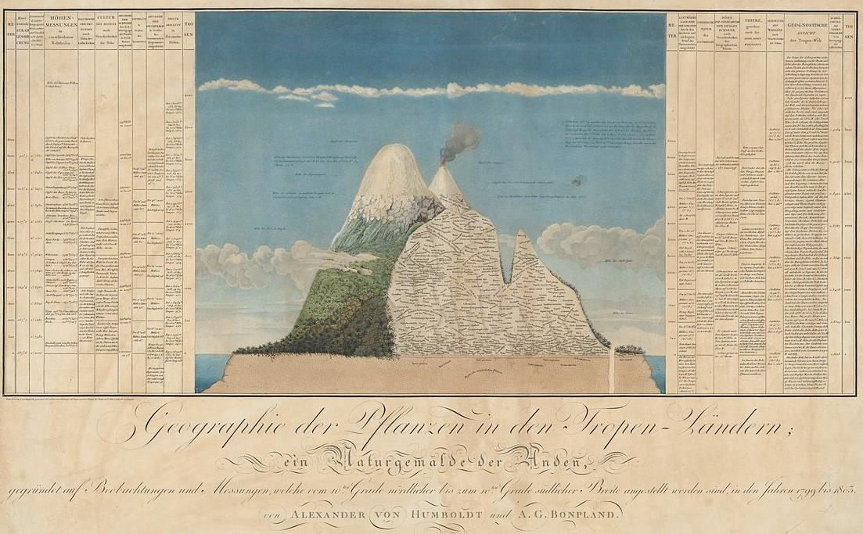
Elevational gradient of species richness
Rahbek (1995) Ecography

Slide 17
The mid domain effect in two dimensions – the spreading dye model
The best model combines the geometric mid-domain effect with climatic effects, specifically actual evapotranspiration (AET).
Storch et al. (2006) Ecology Letters

Slide 18
You should know
Some explanations of macroecological patterns don’t operate with biological mechanisms, but rely on pure geometrical constraints on the world
For example, it was proposed that the tropics are so diverse because they are larger. Unfortunately, that is not the case.
Another example of the geometrical explanation is a “mid domain effect”, which also works well in conjunction with some of the more biological mechanisms

Slide 19
2. Climate
Is it warm, wet, productive, or stable climate that generates high biodiversity?

Slide 20
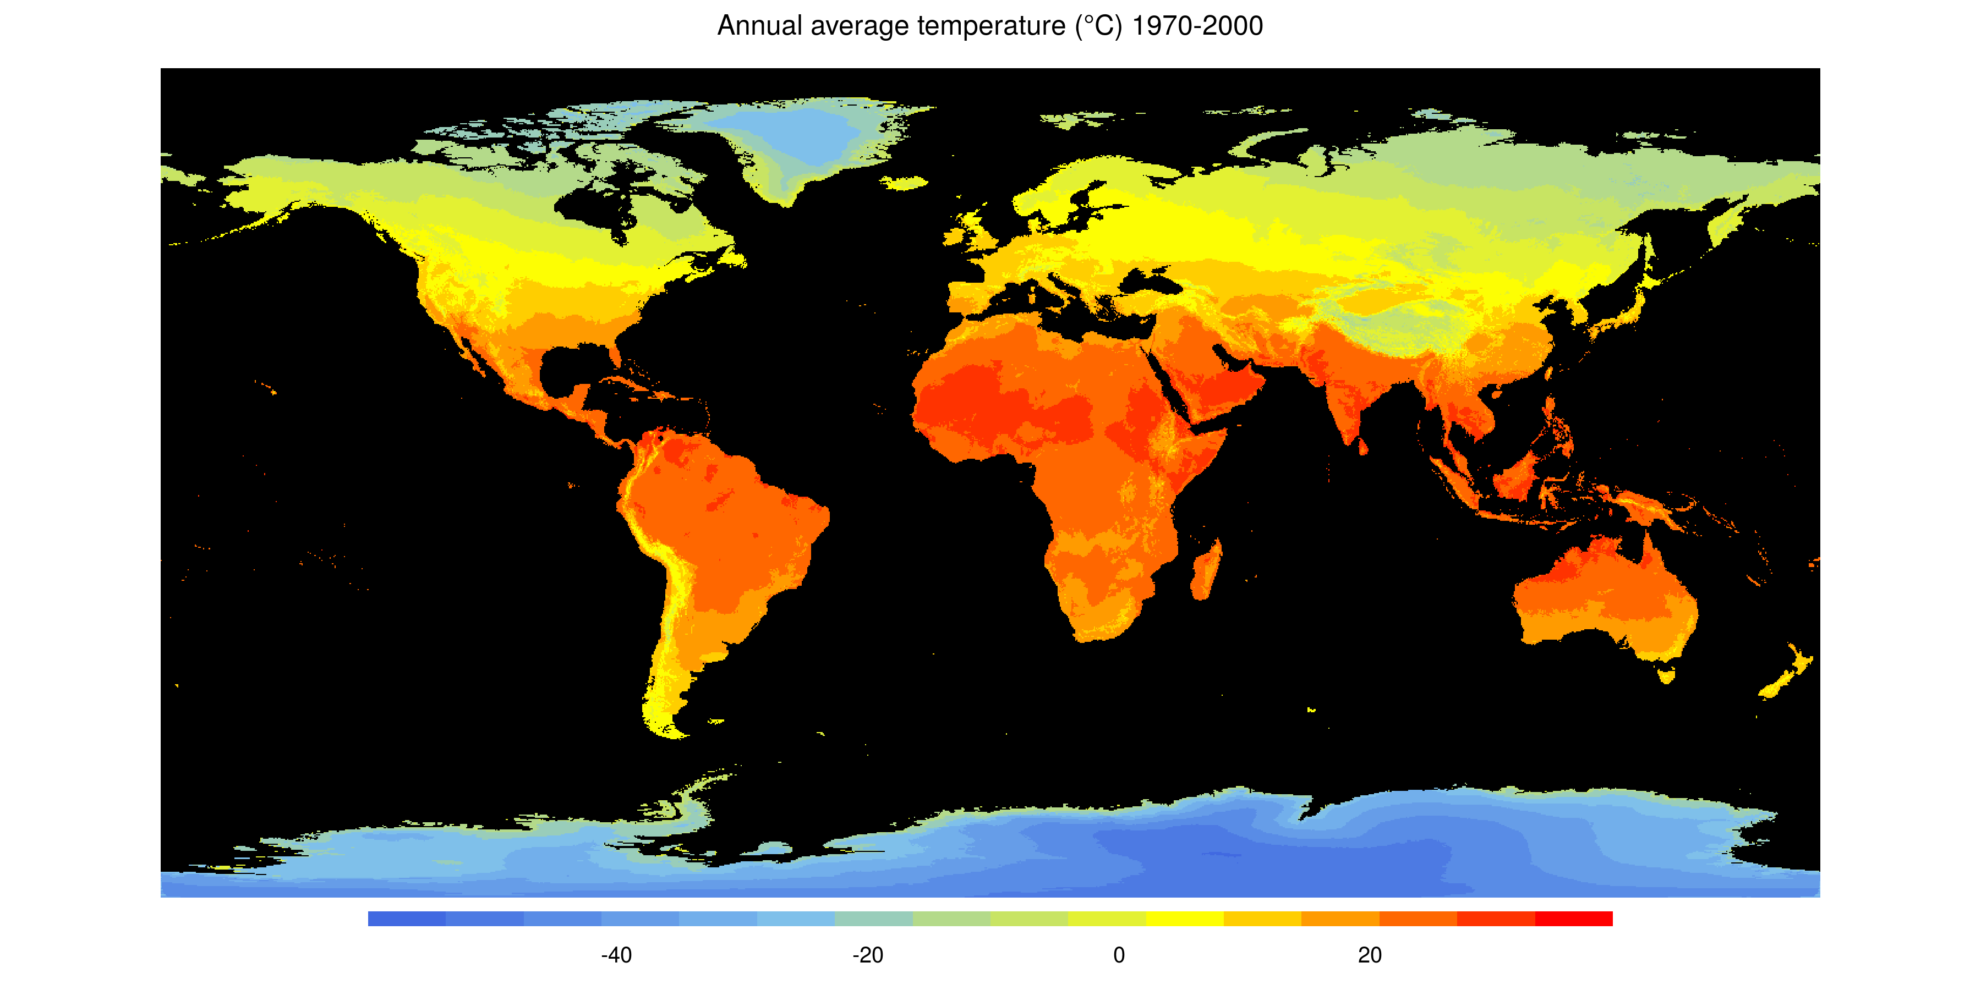
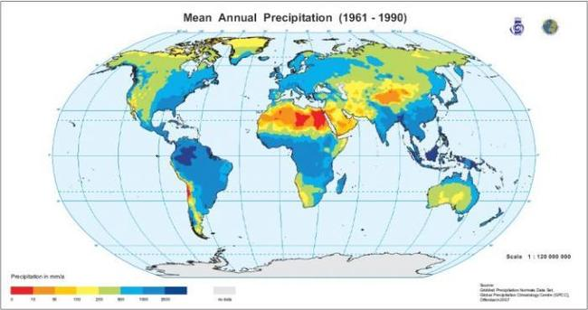
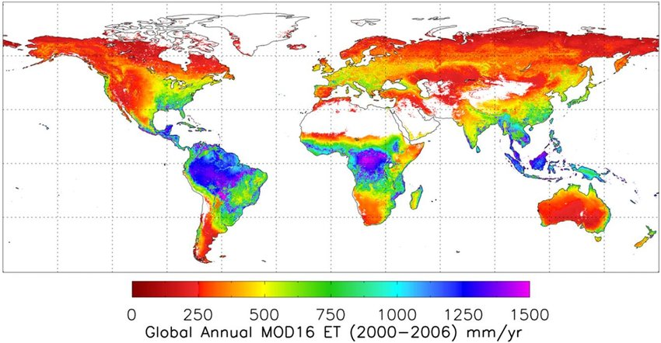
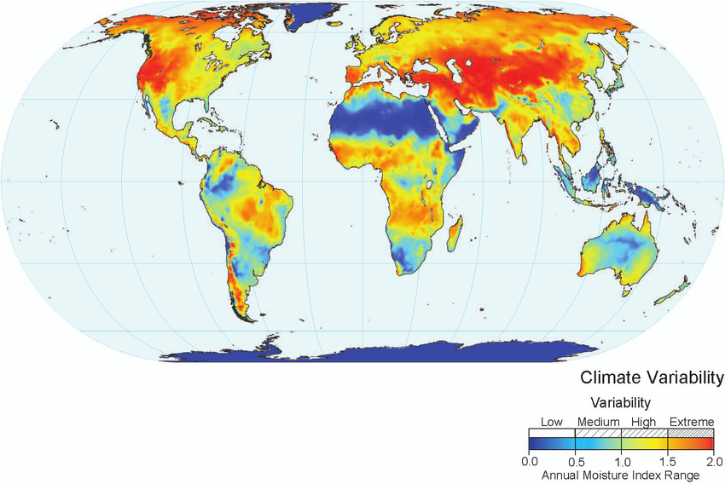
Temperature, precipitation, evapotranspiration, variability (seasonality)

Slide 21
Evapotranspiration – a proxy for energy input
Global species richness of birds
Hawkins et al. (2003) Ecology

Slide 22
Evapotranspiration – a proxy for energy input
Hawkins et al. (2003) Ecology

Slide 23
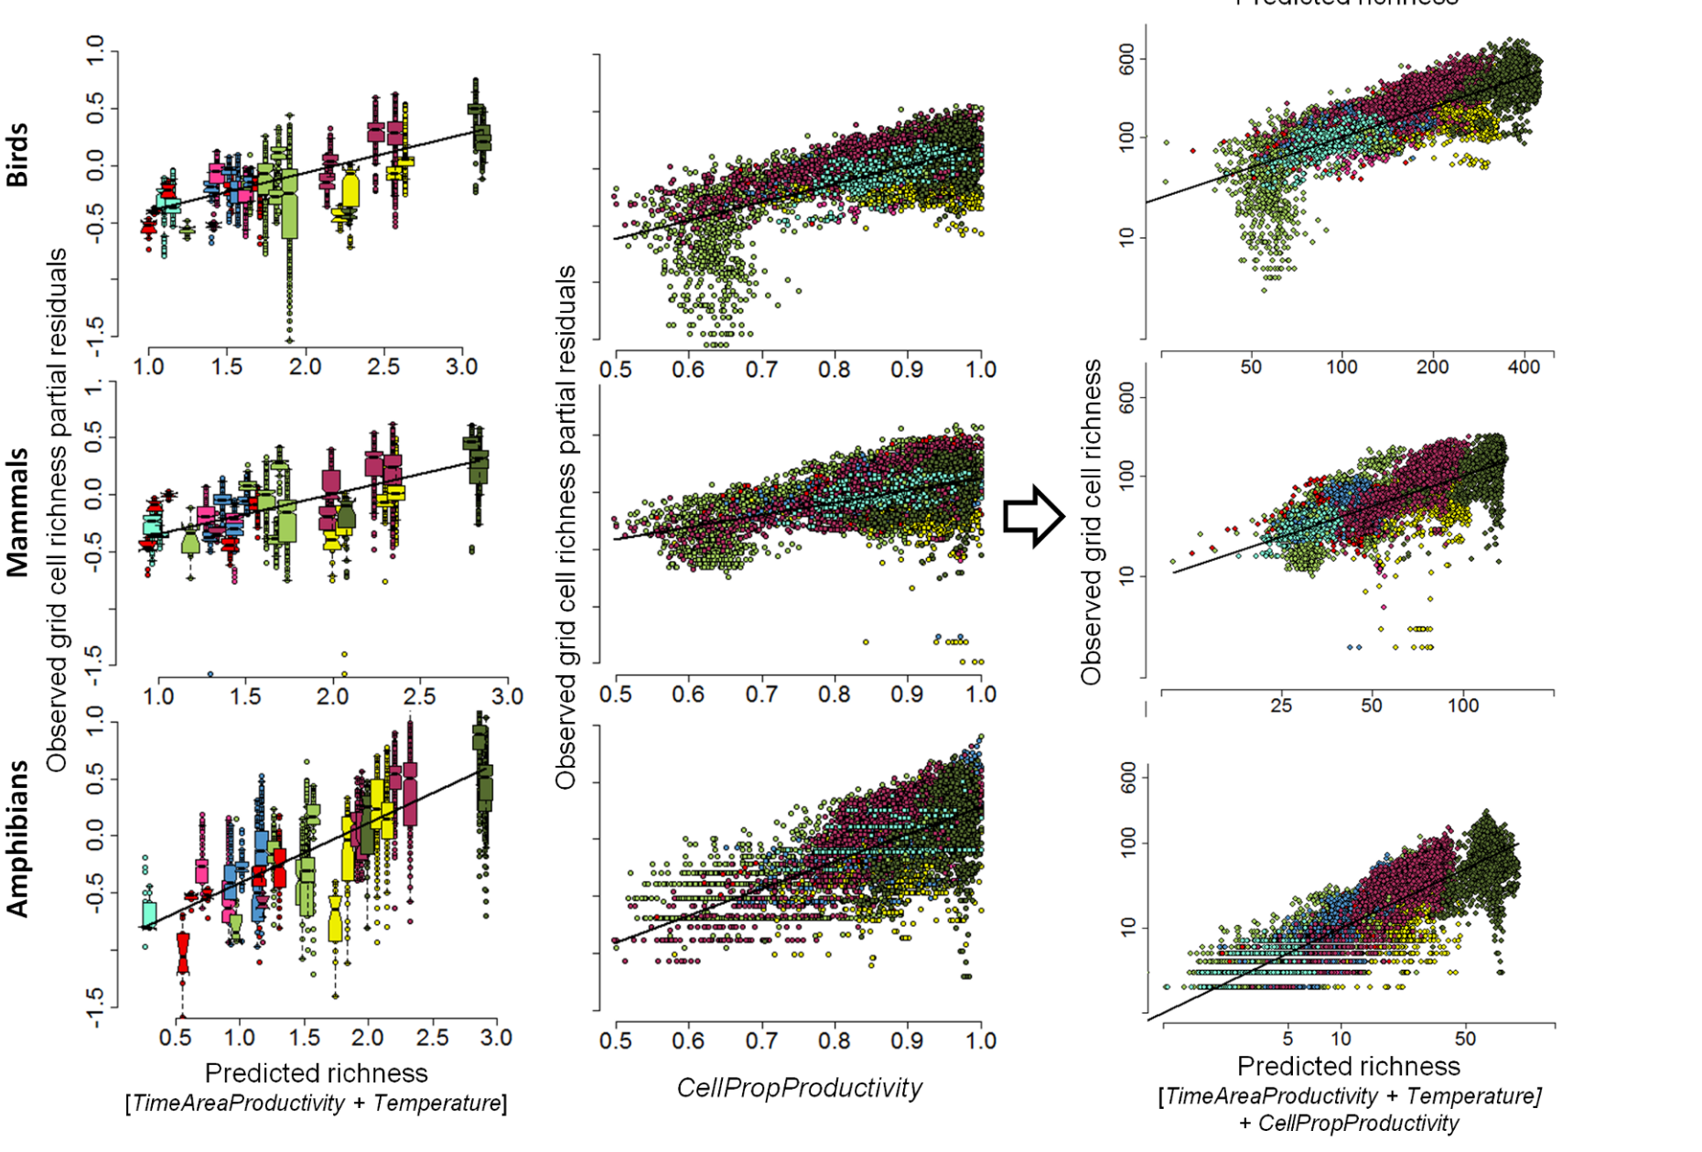
Net Primary Productivity
Jetz & Fine (2012) PLoS Biology

Slide 24
More individuals hypothesis (MIH)
The MIH states that when there is more energy available, there are more individuals, thus populations are on average larger, thus they are less susceptible to extinctions, thus there is higher species richness.
Storch et al. (2019) Ecology Letters

Slide 25
Rohde’s hypothesis
Warmer areas:
-> faster reactions -> more mutations -> faster speciation
or
-> faster generation times -> faster speciation
Rohde (1992) Oikos

Slide 26
Metabolic theory – faster metabolism, faster evolution, faster speciation, more species
Simova et al. (2011) Global Ecology and Biogeography

Slide 27
Metabolic theory – faster metabolism, faster evolution
Allen et al. (2002) Science

Slide 28
Climatic limits
Simova et al. (2011) Global Ecology and Biogeography

Slide 29
Climatic limits
Simova et al. (2011) Global Ecology and Biogeography

Slide 30
You should know
Species diversity strongly and consistently covaries with climate, with warmer and wetter areas being usually richer in species
The best proxy for this warm & wet environments is evapotranspiration, and net primary productivity
Several hypotheses/theories have been proposed to explain this, for example:
The more individuals hypothesis
Metabolic theory
The effect of climatic limits

Slide 31
3. Environmental heterogeneity
More habitats, more species?
Notes:
I am qualified to deliver all this

Slide 32
Empirical support – a global meta-analysis
Stein, Gerstner & Kreft (2014) Ecology Letters

Slide 33
Empirical support – a global meta-analysis
Stein, Gerstner & Kreft (2014) Ecology Letters

Slide 34
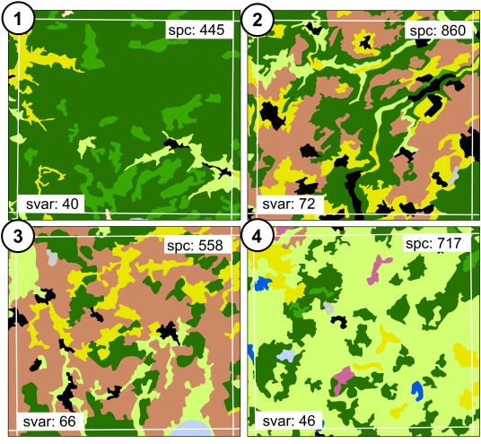
Spectral variability hypothesis
Rocchini et al. (2010) Ecol. Informatics
Féret & Asner (2011) Rem. Sens. Environ.

Slide 35
You should know
Species diversity is broadly expected to co-vary with environmental heterogeneity
The logic is that more heterogeneous environments will offer more opportunities to species with different niches
The relationship is often observed, but it is not as strong as the relationship between diversity and climate

Slide 36
4. Dispersal limits, history, evolution

Slide 37
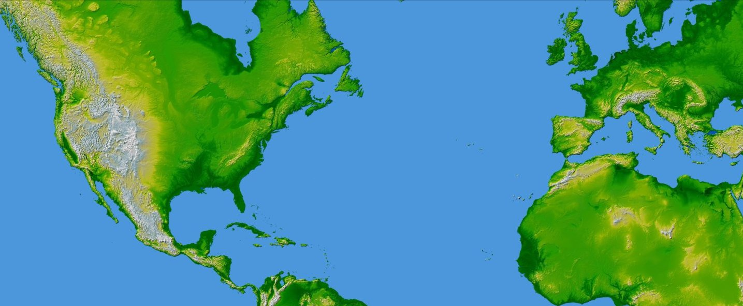
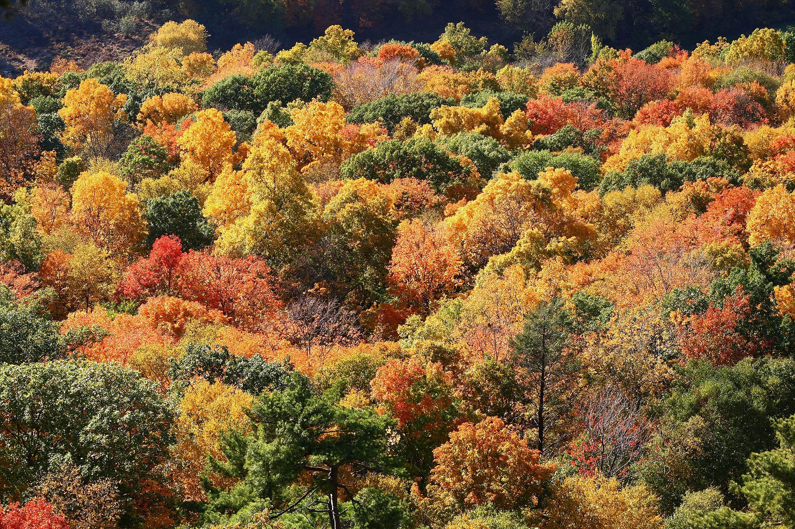
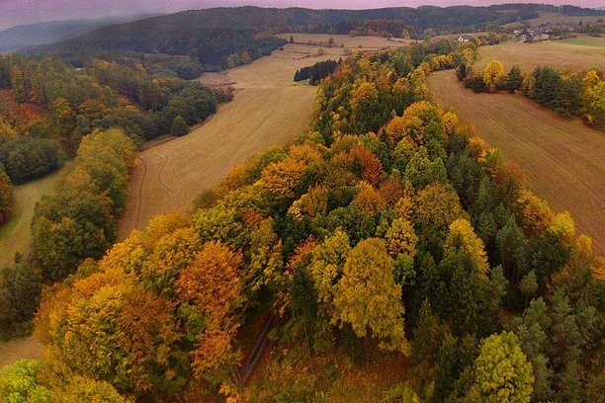
Dispersal limits
X
Connecticut, USA
Czech Republic, EU
Ricklefs & Schluter (1993), Keil & Chase (2019) Nature Ecology & Evolution
map from NASA (public domain)

Slide 38
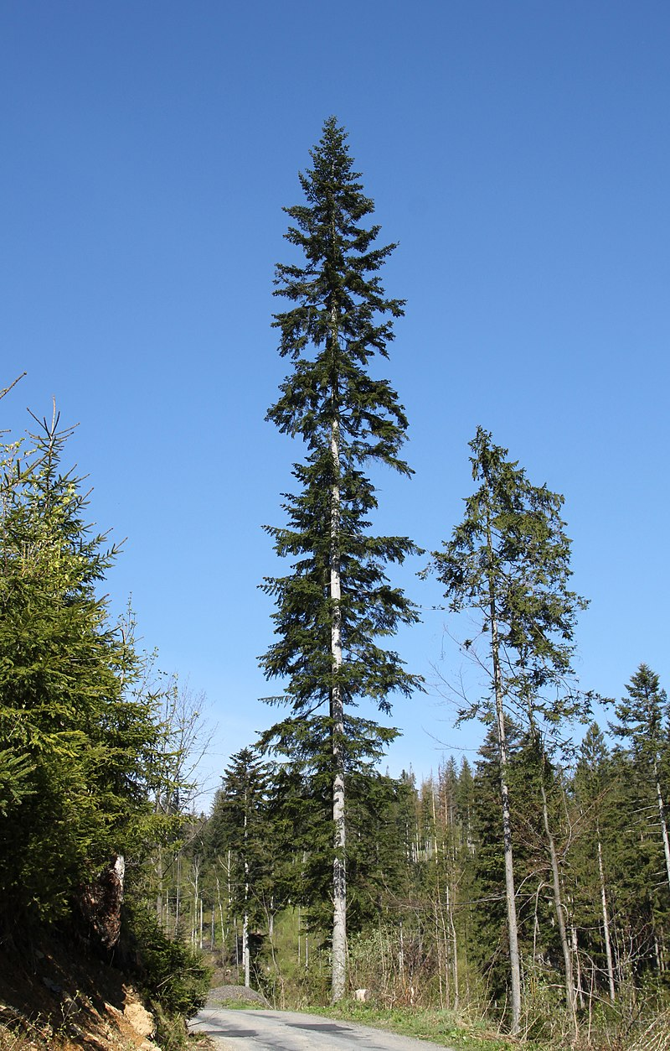
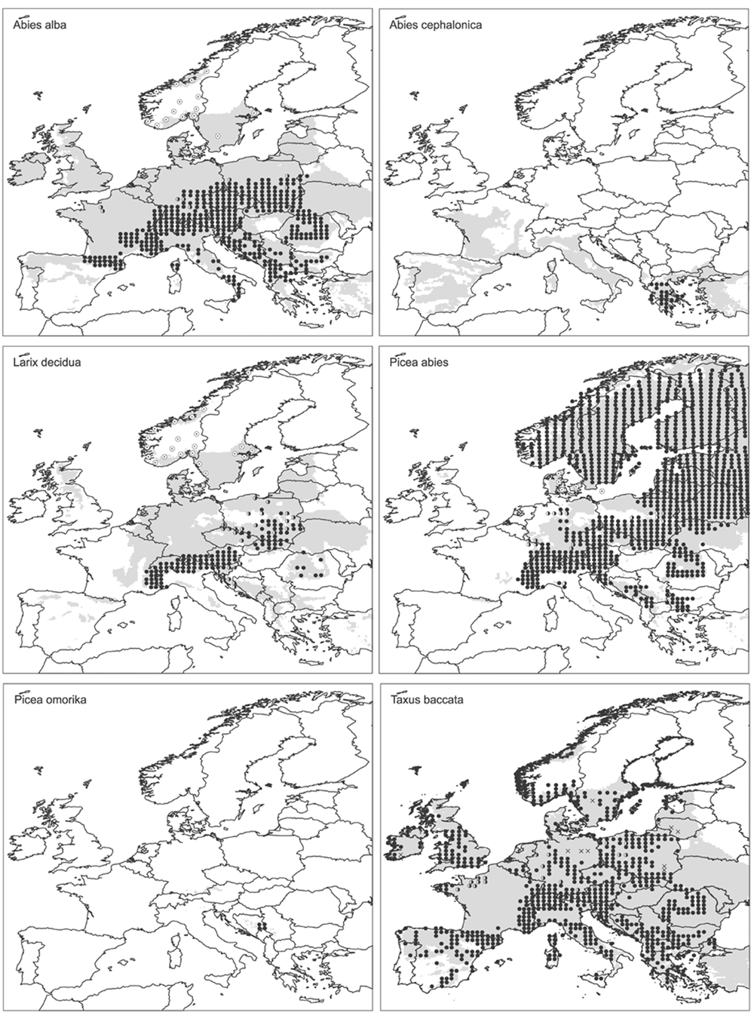
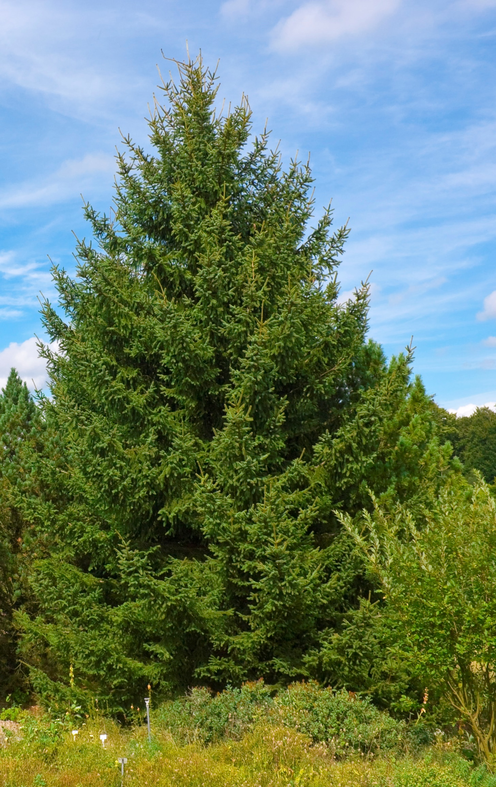
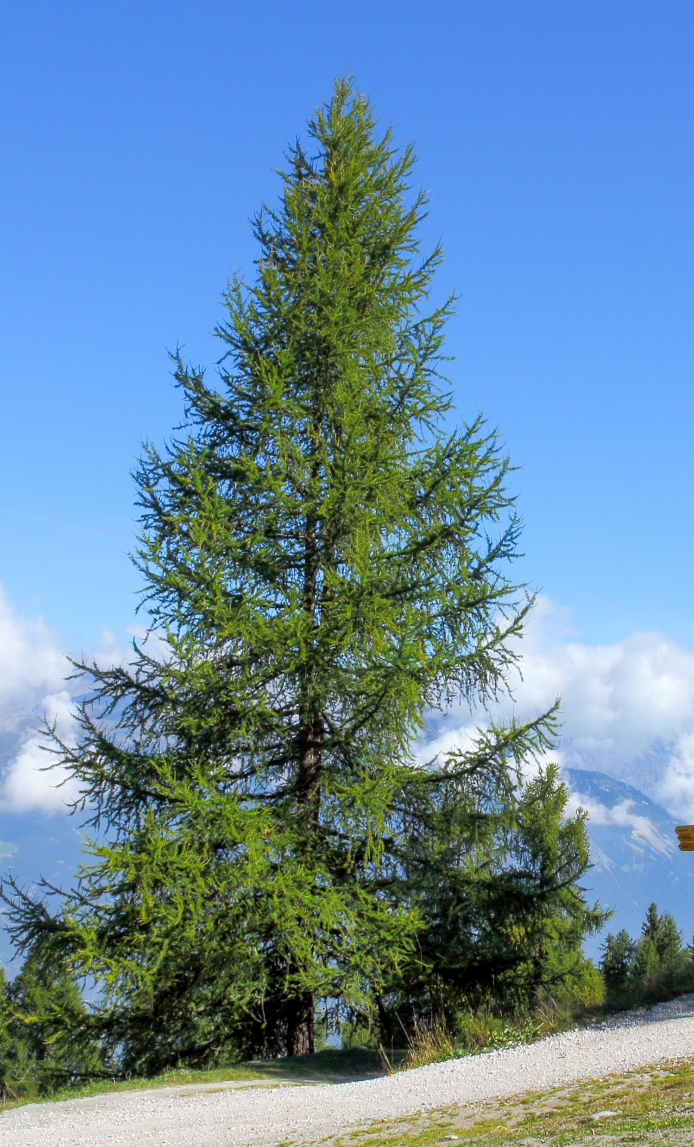
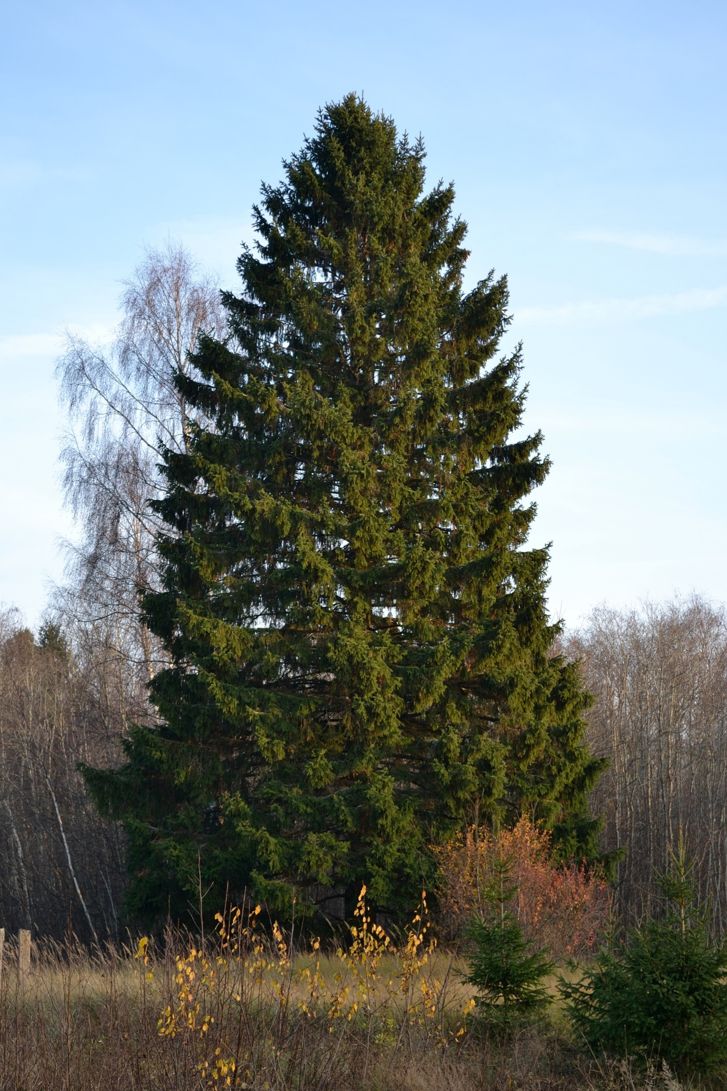
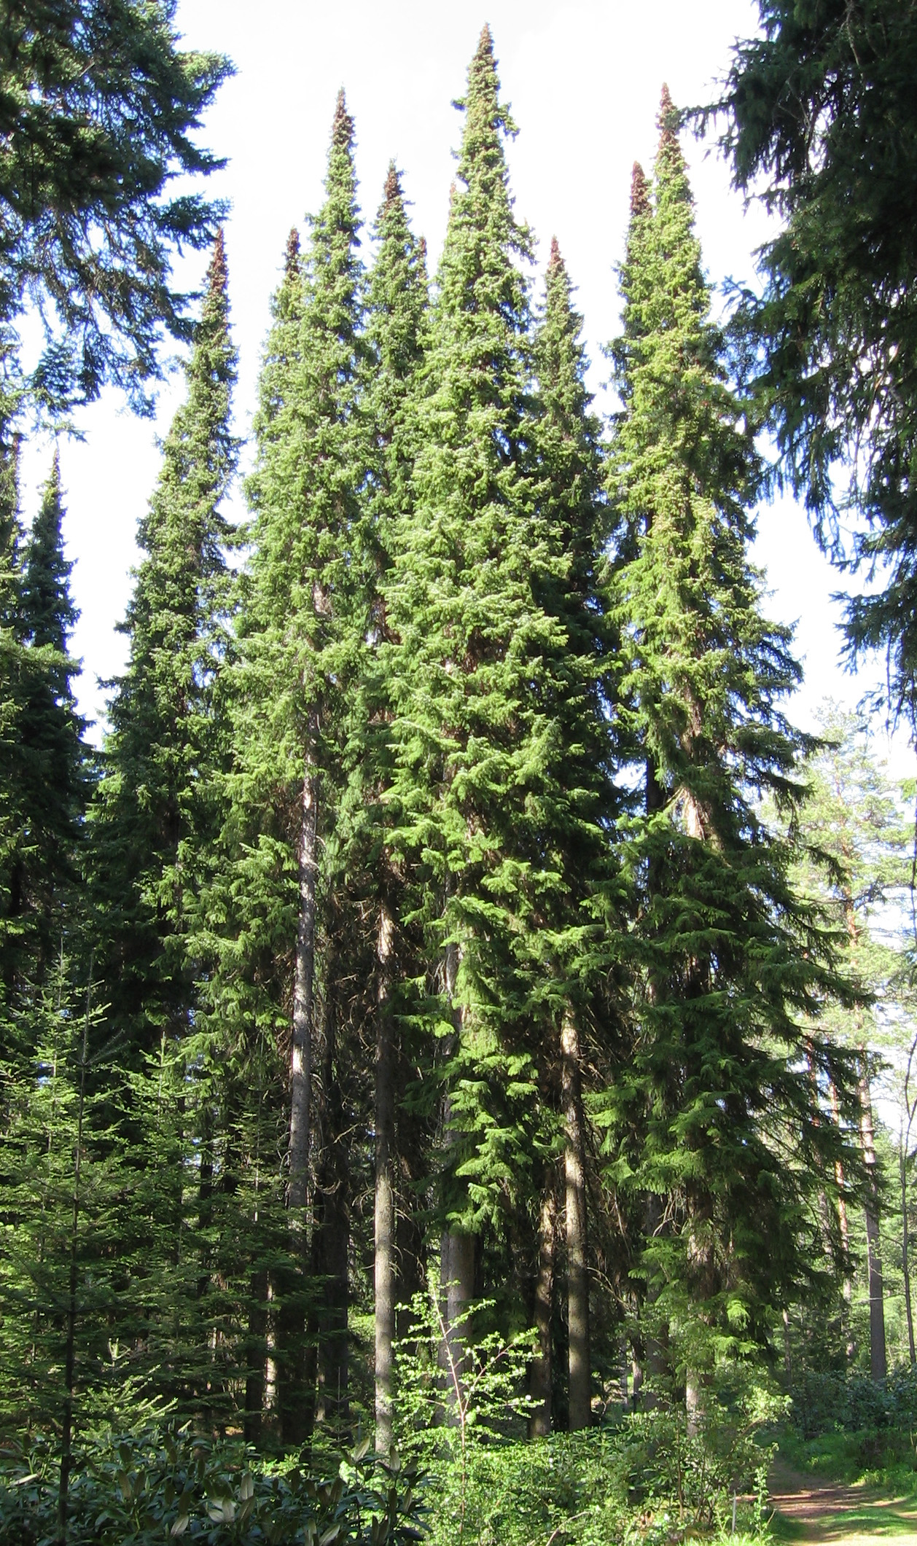
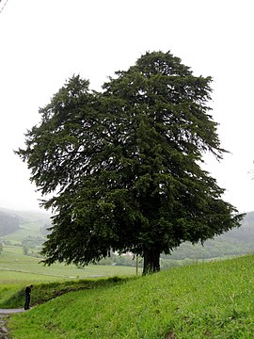
Dispersal limits
Svenning & Skov (2004) Ecology Letters

Slide 39
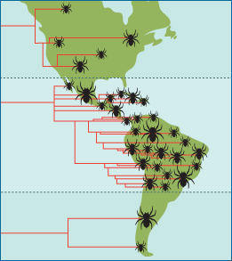
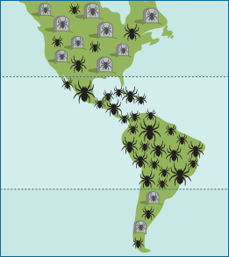
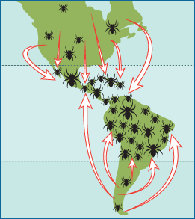
Tropics as cradle, or museum of biodiversity
Tropics as a
cradle of biodiversity
Tropics as a
museum of biodiversity
Tropics as a
destination of biodiversity
= higher speciation in the tropics
= lower extinciton in the tropics
evolution.berkeley.edu

Slide 40
Tropics as cradle, or museum of biodiversity
Rangel et al. (2018) Science
https://players.brightcove.net/53038991001/default_default/index.html?videoId=5810230822001

Slide 41
You should know
Species dispersal limitations, and dispersal barriers play a crucial role in shaping global patterns of species diversity
Examples are European trees, whose diversity still catches up with environmental changes that happened after the last glacial maximum
Often, dispersal limitations are linked to “historical” explanations of the latitudinal diversity gradient
Prominent historical explanations are that the tropics are either a cradle, a museum, or a destination for diversity
Which of these three applies has still not been unequivocally resolved

Slide 42
Synthesis?
… and the role of scale in all this

Slide 43
Broadly, there is empirical support for most of these hypotheses
But … climatic drivers are most common.
Climate
Edaphic
Interacitons
Heterogeneity
Area
Dispersal, history
Field et al. (2009) Journal of Biogeography

Slide 44
And it is also all dependent on spatial grain
Field et al. (2009) Journal of Biogeography

Slide 45
And there is the problem of collinearity
Keil & Chase (2019) Nature Ecology and Evolution

Slide 46
You should know
Among the different explanations for the latitudinal gradient, many apply simultaneously
The strongest driver so far appears to be climate
However, the explanations are difficult to tease apart using only observational data, since geographic location, climate, and geometrical arrangements of continents are all correlated

Slide 47
Altitudinal (elevation) gradients of biodiversity
From the sea level upwards
Notes:
I am qualified to deliver all this

Slide 48
Elevational gradient of species richness
On top of the usual suspects that apply for latitude (e.g. productivity):
Effect of area
UV radiation
Gravitation (water flows down)
Refugia
Quintero & Jetz (2018) Nature

Slide 49
Thank you. Questions?

